Slide 1
Final Output Demo
Part 1
Data Access Layer
Application Layer
Unit Testing

Slide 2
Set Up Part

Slide 3
Prerequisite
Install the following:
JDK (jdk17 recommended) - https://drive.google.com/file/d/1SiO9tbBIhP4TRdMnjqOofsEhk7vfClWP/view?usp=sharing
IntelliJ Idea IDE - https://drive.google.com/drive/folders/1r1alpd-KpNLl9aW-wRMbPIXGt6YlLJhh?usp=sharing
Oracle DB - https://drive.google.com/file/d/1nHaG8VTuepWZ047YnqTcVSbf9CVjN2hz/view?usp=sharing

Slide 4
Prerequisite
Install the following:
SQL Developer - https://drive.google.com/file/d/1NG1U3dqwH0x_xHm-Uy8dc4CJQgdEma3I/view?usp=sharing
* Note that Windows Defender/Security (or any anti malware program) might cause installation issues so you might want do disable this during installation:

Slide 5
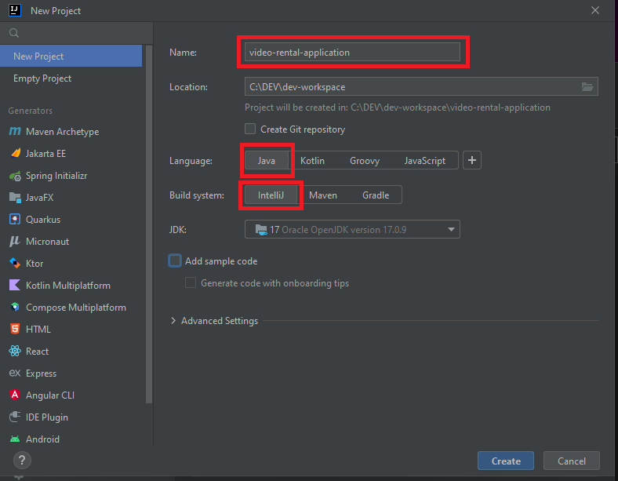
Creating new IntelliJ Project
Note the project naming convention:
all small case
words separated by dashes
for application project, use “application” suffix
for client/UI project, use “app” suffix

Slide 6
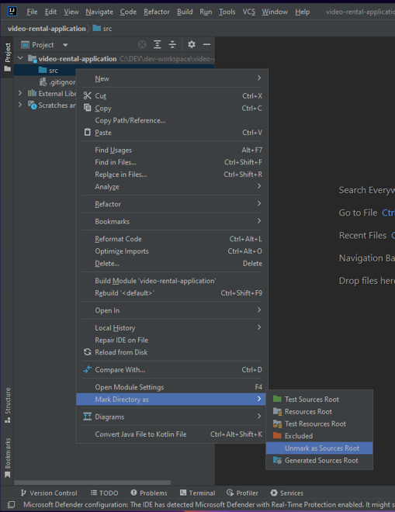
Project Setup
Under project name, right click on src > Mark Directory as > Unmark as Sources Root
Right click again on src > New > Directory > name it as main
Right click on main > New > Directory > name it as java
Right click on java > Mark Directory as > Sources Root

Slide 7
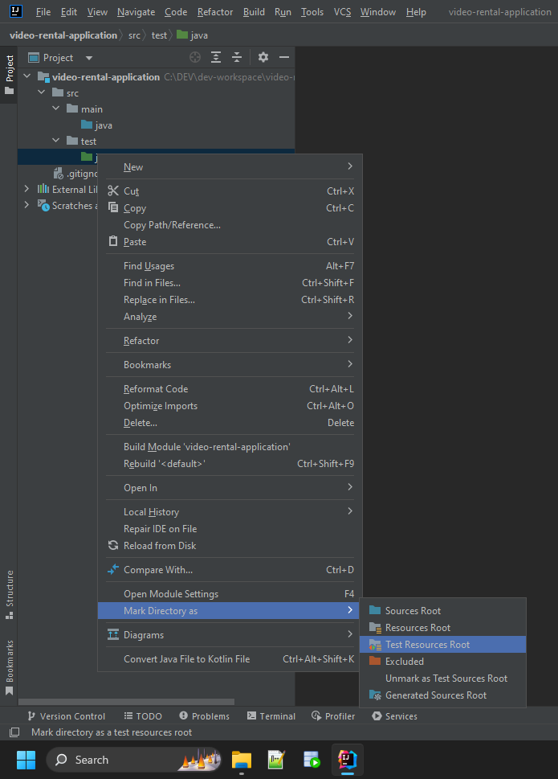
Project Setup
Right click again on src > New > Directory > name it as test
Right click on test > New > Directory > name it as java
Right click on java > Mark Directory as > Test Sources Root

Slide 8
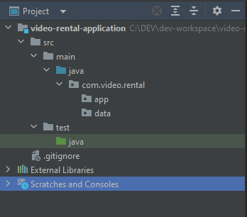
Project Structure
src as the root directory
main contains the application logic and data access
test contains the unit tests and other possible tests
src>main>java.com.<project>.app contains the application layer codes
src>main>java.com.<project>.data contains the data access layer codes
src >test>java.com.<project>.<path> contains the test sources

Slide 9
Database Design Part

Slide 10
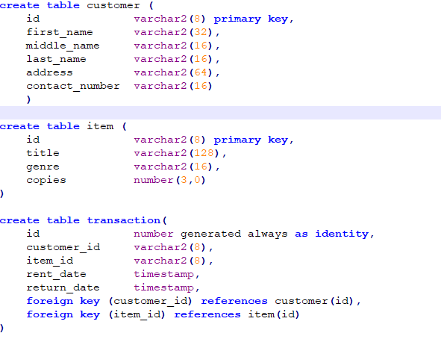
Design Database
Create users and assign privileges
Design and create tables
Create custom user defined types
Create custom user defined functions and procedures
Create other database objects if necessary (views, triggers, etc)
Create test/sample data
sample database design - https://drive.google.com/file/d/1lCekyZBPulBJoF-q5JRFLSUNdHOIICQF/view?usp=sharing

Slide 11
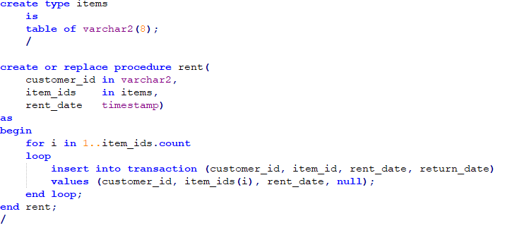
Design Database

Slide 12
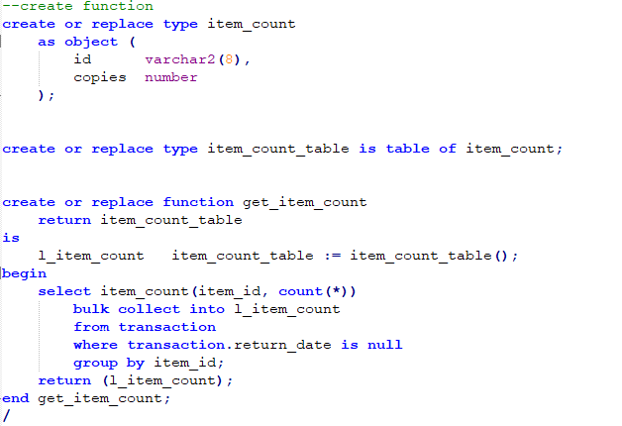
Design Database

Slide 13
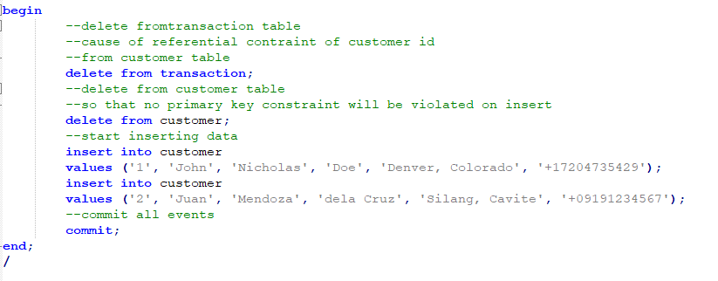
Design Database

Slide 14
Database Access Layer Part

Slide 15
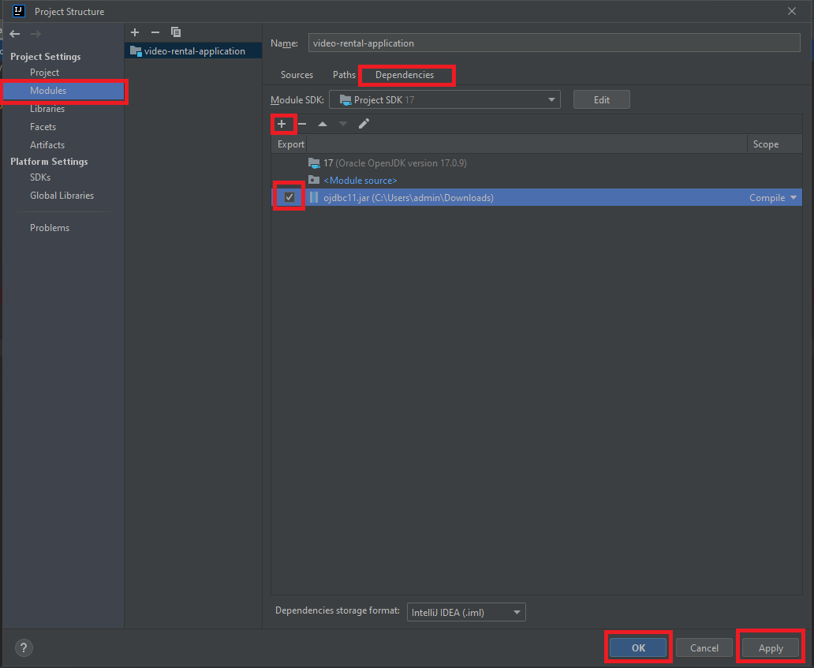
Creating database connection using ojdbc jar
Download ojdbc11.jar which is compatible for jdk11 and above - https://drive.google.com/file/d/1lSSAyRWpWlfrLKqGVNuh0nfm6oBy8mgw/view?usp=sharing
Add ojdbc11.jar as IntelliJ project dependency. File > Project Structure > Under Project Settings select Modules > Dependencies > + sign > JARs or Directories > locate the jar then OK > check Export then Apply then OK

Slide 16
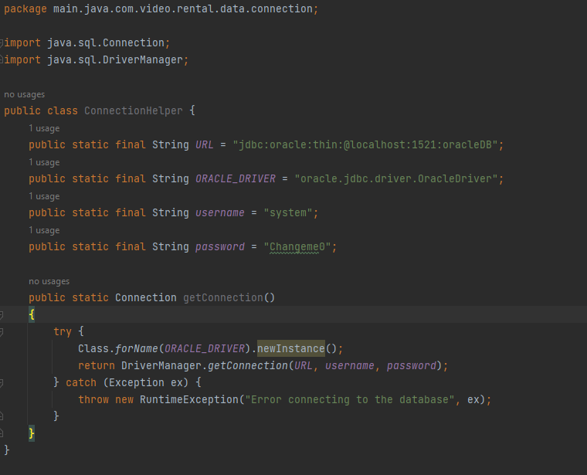
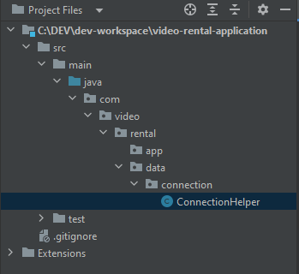
Creating the ConnectionHelper class

Slide 17
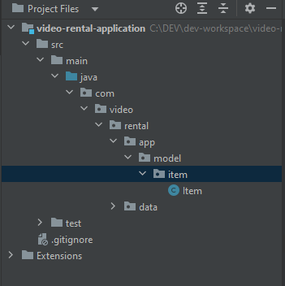
Creating the a model class (POJO)
A POJO consists
fields
optional no-parameter constructor
optional parameterized constructor/s
getters and setters
optional object method overrides (e.g. toString())

Slide 18
The DAO Pattern
The Data Access Object (DAO) pattern is a structural pattern that allows us to isolate the application/business layer from the persistence layer (usually a relational database but could be any other persistence mechanism) using an abstract API.
The API hides from the application all the complexity of performing CRUD operations in the underlying storage mechanism. This permits both layers to evolve separately without knowing anything about each other.

Slide 19
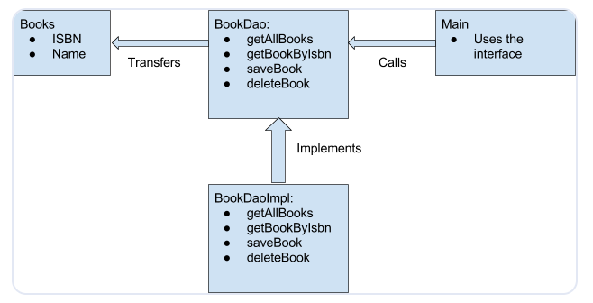
The DAO Pattern

Slide 20
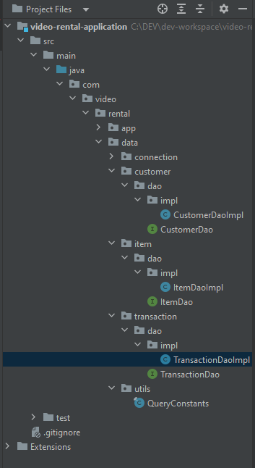
The DAO Pattern
Create models (DONE)
Create interface
Implement interface
Consume in application layer

Slide 21
Sample DAO: ItemDao
List<Item> getAllItems();
Item getItemById(String id);
List<Item> getItemsFromIds(List<String> ids);
boolean addItem(Item item);
boolean updateItem(Item item);
boolean deleteItemById(String id);

Slide 22
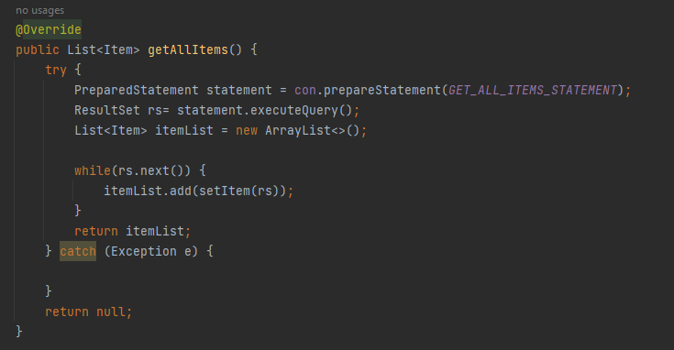
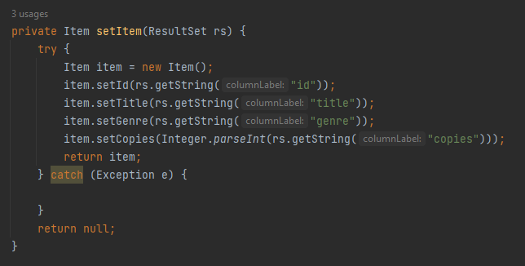
ItemDao Implementation

Slide 23
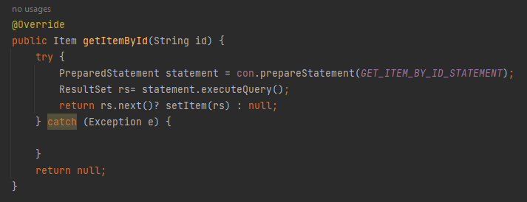
ItemDao Implementation

Slide 24
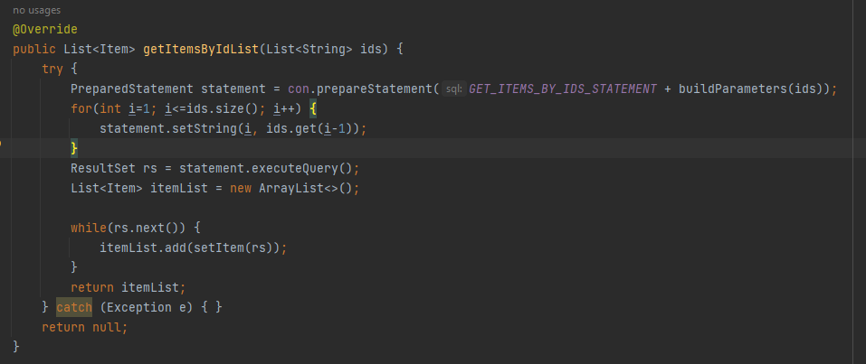
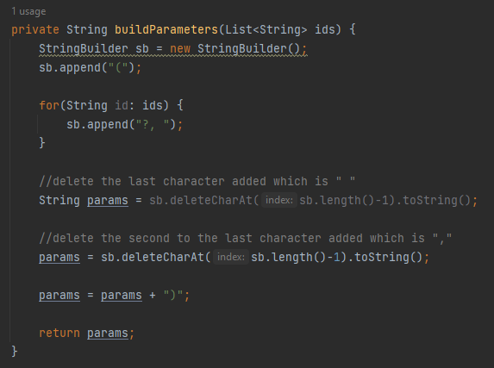
ItemDao Implementation

Slide 25
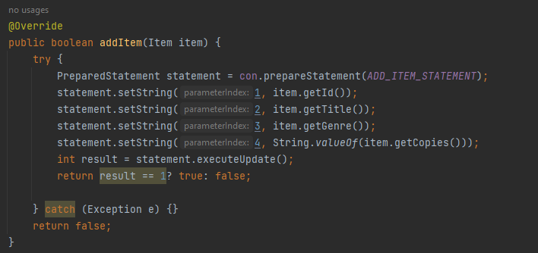
ItemDao Implementation

Slide 26
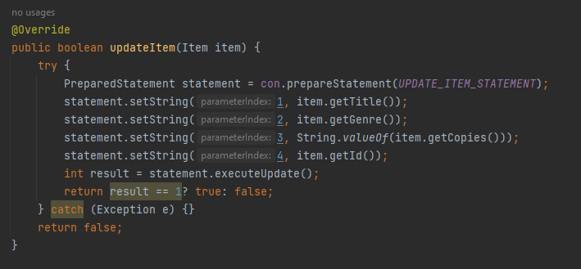
ItemDao Implementation

Slide 27
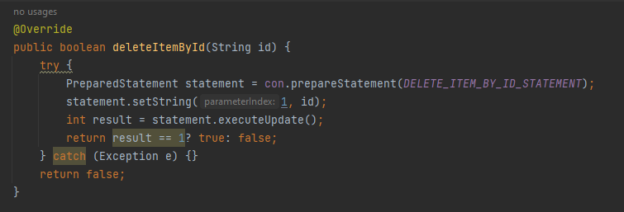
ItemDao Implementation

Slide 28
Application Layer Part

Slide 29
The Application Layer
The application tier, also known as the logic tier or middle tier, is the heart of the application. In this tier, information collected in the presentation tier is processed - sometimes against other information in the data tier - using business logic, a specific set of business rules. The application tier can also add, delete or modify data in the data tier.

Slide 30
The Façade Pattern
Facade pattern hides the complexities of the system and provides an interface to the client using which the client can access the system. This type of design pattern comes under structural pattern as this pattern adds an interface to existing system to hide its complexities.
This pattern involves a single class which provides simplified methods required by client and delegates calls to methods of existing system classes.

Slide 31
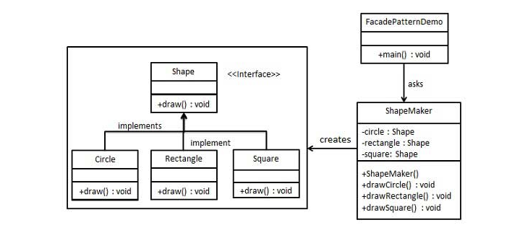
The Façade Pattern

Slide 32
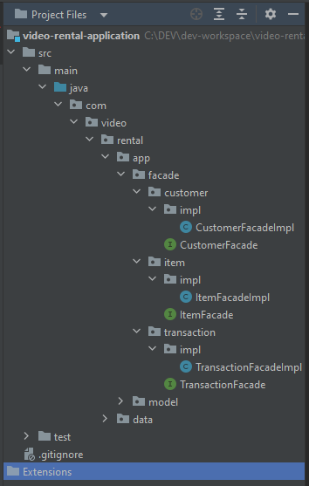
The Façade Pattern
Create façade interface
Create façade implementation
Implement application and/or business logic in the façade implementation

Slide 33
Sample Façade: ItemFacade
List<Item> getAllItems();
Item getItemById(String id);
boolean addItem(Item item);
boolean updateItem(Item item);
boolean deleteItemById(String id);

Slide 34
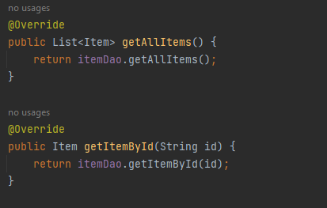
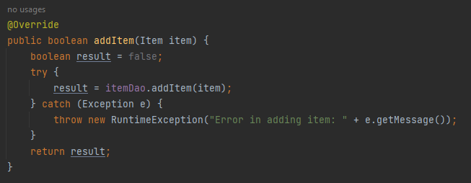
ItemFacade Implementation

Slide 35
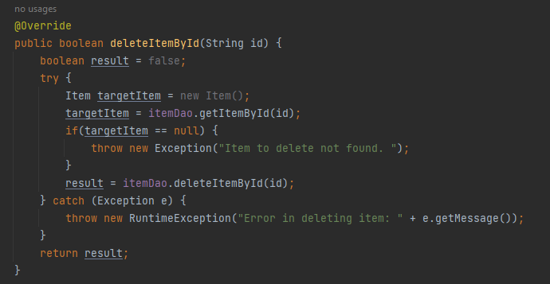
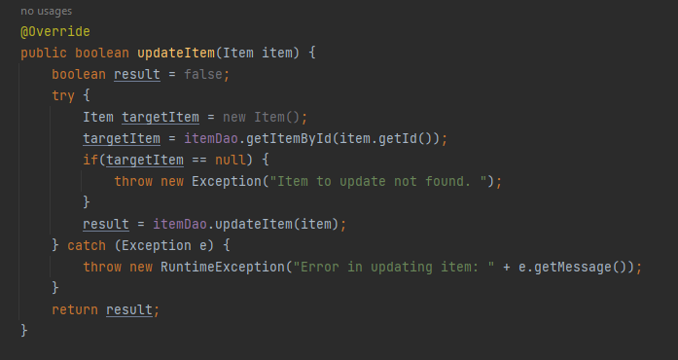
ItemFacade Implementation

Slide 36
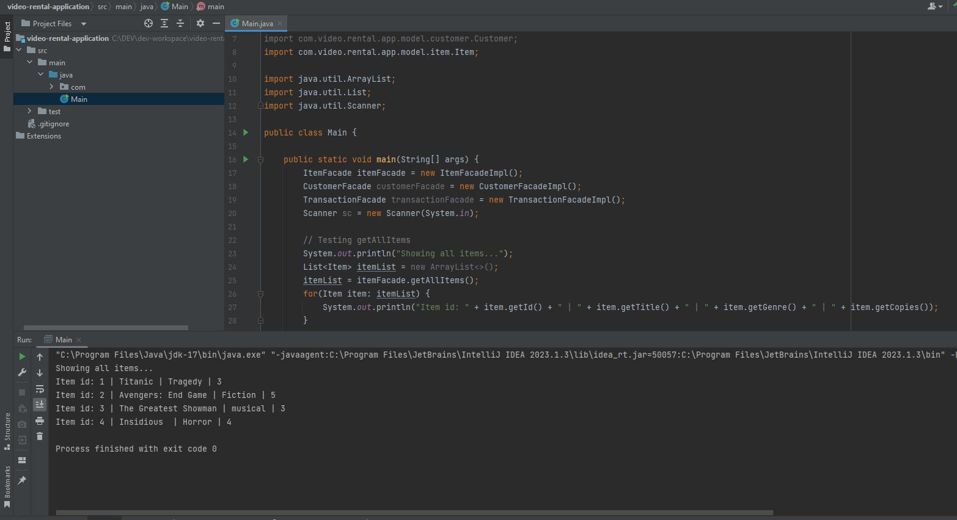
Consuming the “services” of ItemFacade

Slide 37
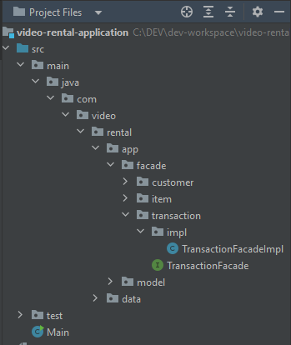
The Transaction module
Lending items to customer
Returning items to the shop

Slide 38
Unit Testing using JUnit

Slide 39
Unit Testing
Unit testing is a type of software testing that focuses on individual units or components of a software system. The purpose of unit testing is to validate that each unit of the software works as intended and meets the requirements. Unit testing is typically performed by developers, and it is performed early in the development process before the code is integrated and tested as a whole system.

Slide 40
JUnit
JUnit is a simple framework to write repeatable tests.
Unit promotes the idea of "first testing then coding", which emphasizes on setting up the test data for a piece of code that can be tested first and then implemented. This approach is like "test a little, code a little, test a little, code a little." It increases the productivity of the programmer and the stability of program code, which in turn reduces the stress on the programmer and the time spent on debugging.

Slide 41
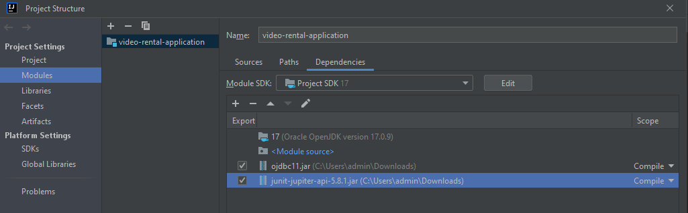
JUnit Setup
Download junit-jupiter-api-<version>.jar : https://drive.google.com/file/d/1RDB6q8GmUblnCWP2cxGoqHuM0RFzLsIP/view?usp=sharing
Import the jar in the project dependencies

Slide 42
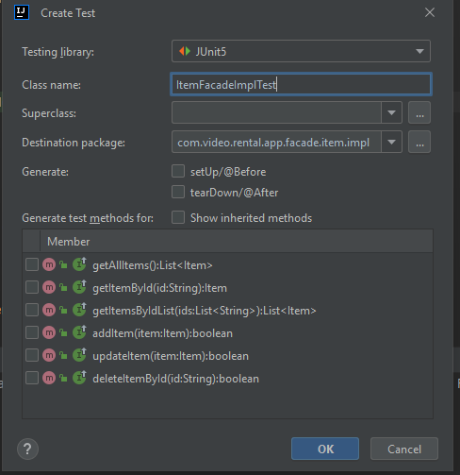
JUnit Setup
Select the file you need to create a test then press Ctrl + Shift + T > Create New Test...
Fill in necessary fields then OK

Slide 43
Creating unit tests
Setup phase
Testing phase
Assertion phase

Slide 44
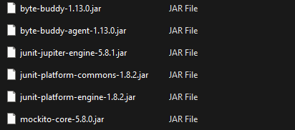
Other dependencies
https://drive.google.com/file/d/1LFa6W3oa8NHhUxztD_-9lGCp9WfvIDLv/view?usp=sharing

